Slide 1
SDLC Lifecycle
7 phases
1. Planning
2.Analysis
3.Design phase
4. Development Phase
5.Testing phase
6.Deployement phase
7. Maintenance Phase

Slide 2

Phase 1 :Planning
1.Software project starts with an idea, the construction of a house begins with the conception of a design or blueprint.
2. Real life : During this phase, architects and homeowners collaborate to outline the layout, features, and specifications of the house, considering factors like location, size, budget, and aesthetic preferences.

Slide 3

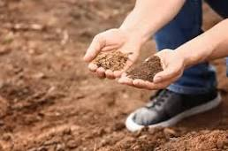
Phase 2 : Analysis
They analyze the homeowner's requirements and local building codes to ensure compliance.
Site Survey
Soil test
Identifying potential conflicts or ambiguities in requirements and resolving them through discussions with stakeholders.

Slide 4
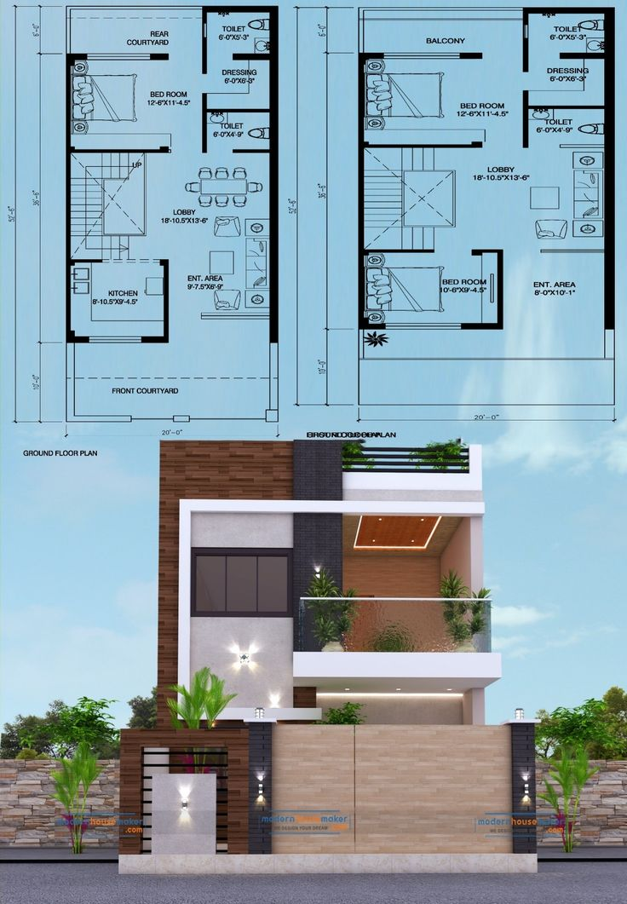
Phase 3: Design Phase
create detailed architectural plans and construction drawings for the house. They design the floor plan, exterior elevations, interior layout, and structural components.

Slide 5
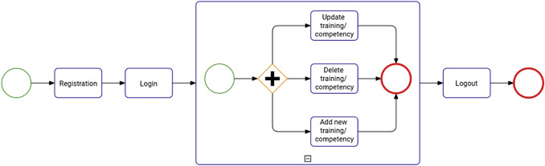
System Design: High-level structure of the software, dividing system into module and components
Detailed Design: Design of ndividual components or modules.
User Interface Design: User-friendly UI design is done
Database Design: Database schema , Entity-relationship diagrams (ERDs)

Slide 6
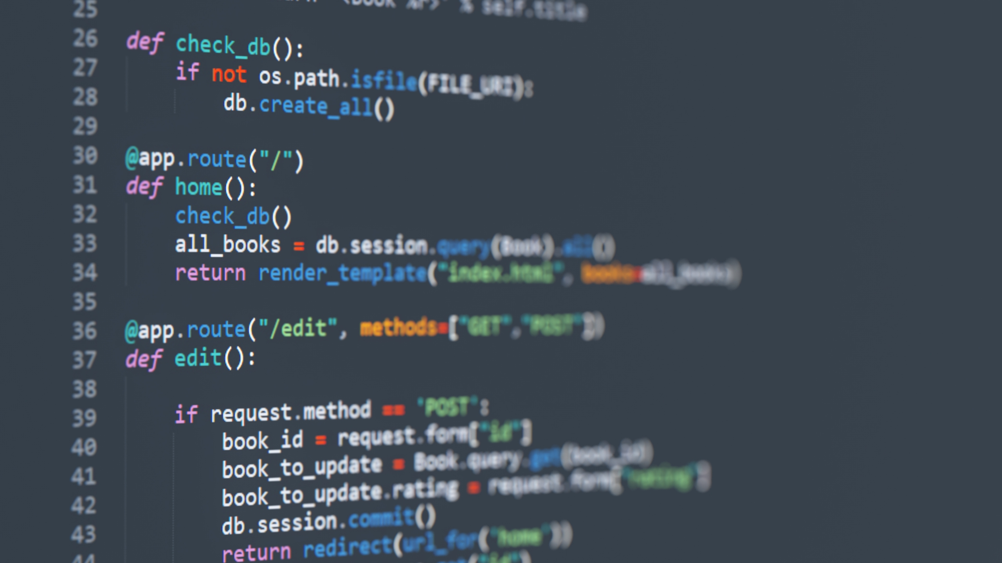
Phase 5: Development Phase
Start building the house
Development teams worked on coding the backend infrastructure and frontend interface of the app.

Slide 7
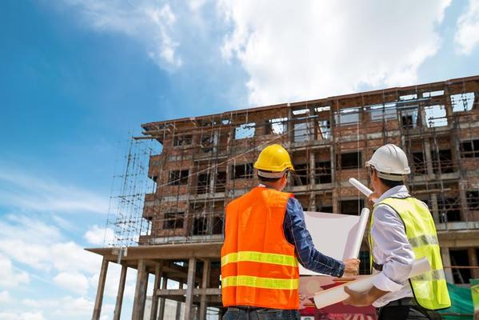
Phase 6: Testing Phase
Inspectors and quality assurance teams conduct inspections and tests to verify that the work meets building codes, safety standards, and quality requirements.

Slide 8
Unit Testing: Testing individual units or components
Integration Testing: Tesing interactions and interfaces between different units or components
System Testing: Evaluates the behavior of the entire software system

Slide 9
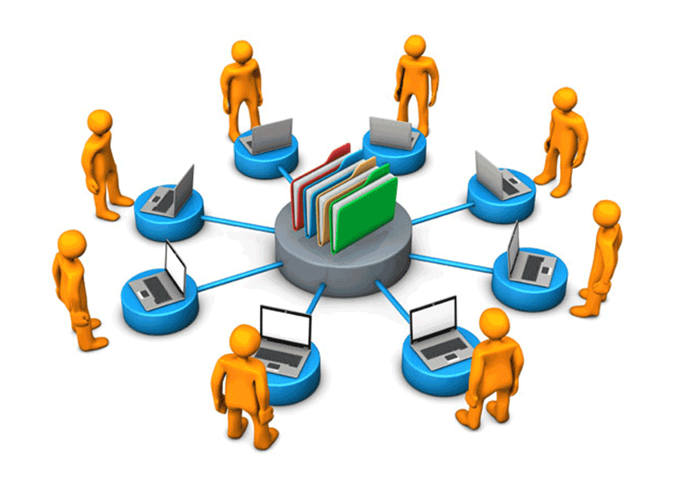
Phase 7: Deployment Phase
House owners move into the new house
Developed software is released and made available for use by end-users

Slide 10

Phase 8 : Maintenance Phase
House owners continue to maintain and care for their house
Ensuring the software's continued functionality, stability, and usability over its operational lifetime

Slide 11
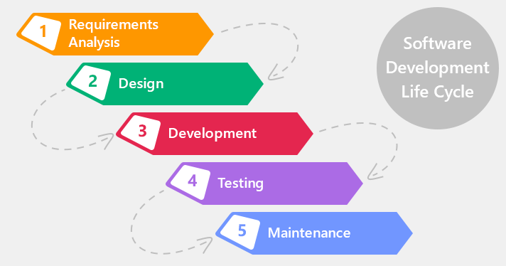
Waterfall Model:

Slide 12
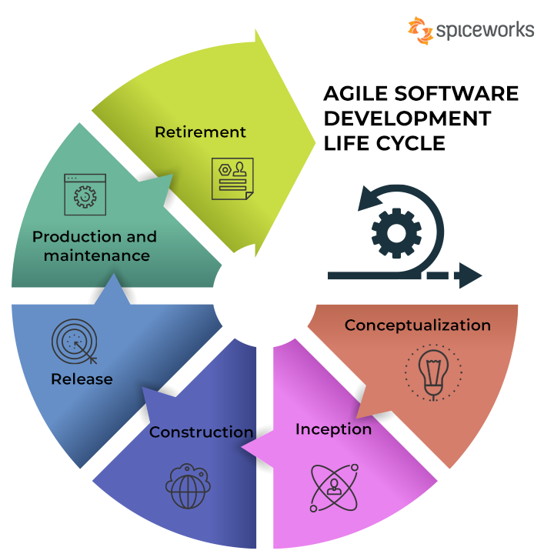
Agile :

